Slide 1
Fundamentals of Predictive Analytics using Machine Learning techniques
(40 hours)
Notes:
Title - The learning outcome
Subtitle - Duration

Slide 2
In this section, we will discuss:
Logistic Regression
Evaluation – Confusion Matrix, Precision, Recall, F1 Score, Accuracy
Python Library – Sci-kit Learn
Notes:
Mention the parent topics one by one.
In this section we will discuss following topics
Logistic Regression
Evaluation – Confusion Matrix, Precision, Recall, F1 Score, Accuracy
Python Library – Sci-kit Learn

Slide 3
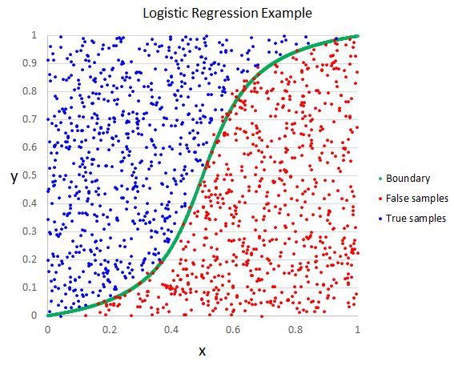
Logistic Regression
What is Logistic Regression?
Logistic regression is a statistical model that in its basic form uses a logistic function to model a binary dependent variable, although many more complex extensions exist. In regression analysis, logistic regression (or logit regression) is estimating the parameters of a logistic model (a form of binary regression).
Image Source: https://helloacm.com/wp-content/uploads/2016/03/logistic-regression-example.jpg
Notes:
Logistic regression is one of the most popular Machine Learning algorithms, which comes under the Supervised Learning technique. It is used for predicting the categorical dependent variable using a given set of independent variables.
Logistic regression predicts the output of a categorical dependent variable. Therefore the outcome must be a categorical or discrete value. It can be either Yes or No, 0 or 1, true or False, etc. but instead of giving the exact value as 0 and 1, it gives the probabilistic values which lie between 0 and 1.
Logistic Regression is much similar to the Linear Regression except that how they are used. Linear Regression is used for solving Regression problems, whereas Logistic regression is used for solving the classification problems.
Reference:
https://www.tutorialspoint.com/internet_technologies/internet_overview.htm/

Slide 4
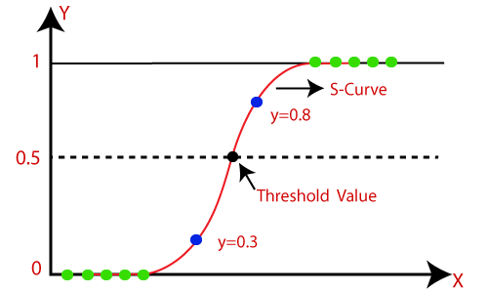
Logistic Regression
Logistic Regression
Logistic Regression can be used to classify the observations using different types of data and can easily determine the most effective variables used for the classification. The below image is showing the logistic function:
Image Source: https://www.javatpoint.com/logistic-regression-in-machine-learning
Notes:
In Logistic regression, instead of fitting a regression line, we fit an "S" shaped logistic function, which predicts two maximum values (0 or 1).
The curve from the logistic function indicates the likelihood of something such as whether the cells are cancerous or not, a mouse is obese or not based on its weight, etc.
Logistic Regression is a significant machine learning algorithm because it has the ability to provide probabilities and classify new data using continuous and discrete datasets.
Logistic Regression can be used to classify the observations using different types of data and can easily determine the most effective variables used for the classification. The below image is showing the logistic function:

Slide 5
Logistic Regression
Logistic Function (Sigmoid Function):
The sigmoid function is a mathematical function used to map the predicted values to probabilities.
It maps any real value into another value within a range of 0 and 1.
The S-form curve is called the Sigmoid function or the logistic function.
Image Source: https://www.javatpoint.com/logistic-regression-in-machine-learning
Notes:
Logistic Function (Sigmoid Function):
The sigmoid function is a mathematical function used to map the predicted values to probabilities.
It maps any real value into another value within a range of 0 and 1.
The value of the logistic regression must be between 0 and 1, which cannot go beyond this limit, so it forms a curve like the "S" form. The S-form curve is called the Sigmoid function or the logistic function.
In logistic regression, we use the concept of the threshold value, which defines the probability of either 0 or 1. Such as values above the threshold value tends to 1, and a value below the threshold values tends to 0.

Slide 6


Logistic Regression
Logistic Regression Equation
We know the equation of the straight line can be written as:
In Logistic Regression y can be between 0 and 1 only, so for this let's divide the above equation by (1-y):
But we need range between -[infinity] to +[infinity], then take logarithm of the equation it will become:
Image Source: https://www.javatpoint.com/logistic-regression-in-machine-learning
Notes:
The Logistic regression equation can be obtained from the Linear Regression equation. The mathematical steps to get Logistic Regression equations are given below:
We know the equation of the straight line can be written as: ( eq -1)
In Logistic Regression y can be between 0 and 1 only, so for this let's divide the above equation by (1-y): ( eq-2)
But we need range between -[infinity] to +[infinity], then take logarithm of the equation it will become: ( eq-3)
The above equation is the final equation for Logistic Regression.

Slide 7
Logistic Regression
Binomial
Multinomial
Ordinal
Types Logistic Regression Equation
Binomial
Multinomial
Ordinal
Notes:
Type of Logistic Regression:
On the basis of the categories, Logistic Regression can be classified into three types:
Binomial: In binomial Logistic regression, there can be only two possible types of the dependent variables, such as 0 or 1, Pass or Fail, etc.
Multinomial: In multinomial Logistic regression, there can be 3 or more possible unordered types of the dependent variable, such as "cat", "dogs", or "sheep"
Ordinal: In ordinal Logistic regression, there can be 3 or more possible ordered types of dependent variables, such as "low", "Medium", or "High".

Slide 8
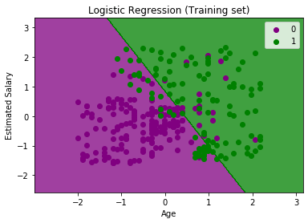
Logistic Regression
Steps in Logistic Regression
Data Pre-processing step
Fitting Logistic Regression to the Training set
Predicting the test result
Test accuracy of the result (Creation of Confusion matrix)
Visualizing the test set result.
Note:- Check out theory Manual for Example
Image Source: https://www.javatpoint.com/logistic-regression-in-machine-learning
Notes:
Steps in Logistic Regression: To implement the Logistic Regression using Python, we will use the same steps as we have done in previous topics of Regression. Below are the steps:
Data Pre-processing step
Fitting Logistic Regression to the Training set
Predicting the test result
Test accuracy of the result (Creation of Confusion matrix)
Visualizing the test set result.

Slide 9
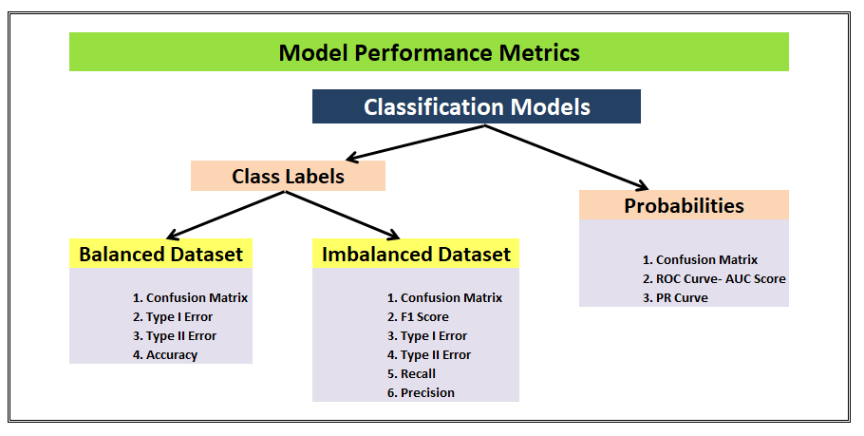
Model Performance Metrics
Logistic Regression Evaluation metrics
Confusion matrix
Precision
Recall
F1 Score
Accuracy
Image Source: https://miro.medium.com/max/1400/1*tlrYPZgfX9cc1_RCPHPoJg.png
Notes:
model performance metrics that can be used to assess the model performance of a classification model.
Following Matrices will be used to assess the model performance of logistic regression classification model.
Confusion matrix
Precision
Recall
F1 Score
Accuracy
Let’s understand by example:
We’ll be using an example of a dataset having yes and no labels to be used to train a logistic regression model. This use case can be of any classification problem — spam detection, cancer prediction, attrition rate prediction, campaign target predictions, etc. We’ll be referring to special use-cases as and when required in this post. For now, we will take into consideration a simple logistic model which has to predict yes or no.
First things first, a logistic model can give two kinds of outputs:
1. It gives out class labels as output values (yes/no, 1/0, malignant/benign, attrited/retained, spam/not spam etc.)
2. It gives probability values between 0 to 1 as output values to signify how likely or how unlikely an event is for a particular observation.
The class labels scenario can be further segmented into the cases of balanced or imbalanced datasets, both of these cannot be judged/should not be judged basis on similar metrics. Some metrics are more suited for but not another and vice-versa. Similarly, the Probabilities scenario has different model performance metrics than the class labels one.

Slide 10
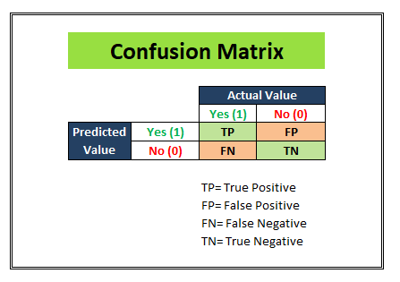
Model Performance Metrics
Confusion matrix
A confusion matrix is a table that is often used to describe the performance of a classification model (or “classifier”) on a set of test data for which the true values are known.
Image Source: https://miro.medium.com/max/1400/1*tlrYPZgfX9cc1_RCPHPoJg.png
Notes:
We start with a development dataset while building any statistical or ML model. Divide that dataset into 2 parts: Training and Test. Keep aside the test dataset and train the model using the training dataset. Once the model is ready to predict, we try making predictions on the test dataset. And once we segment the results into a matrix similar to as shown in the above figure, we can see how much our model is able to predict right and how much of its predictions are wrong.
We populate the following 4 cells with the numbers from our test dataset(having 1000 observations for instance).

Slide 11
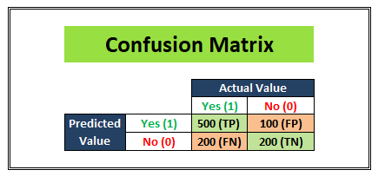
Model Performance Metrics
Confusion matrix
TP (True-positives):
TN (True-negatives):
FP (False-positives):
FN (False-negatives):
Image Source: https://miro.medium.com/max/1400/1*tlrYPZgfX9cc1_RCPHPoJg.png
Notes:
TP (True-positives): Where the actual label for that column was “Yes” in the test dataset and our logistic regression model also predicted “Yes”. (500 observations)
TN (True-negatives): Where the actual label for that column was “No” in the test dataset and our logistic regression model also predicted “No”. (200 observations)
FP (False-positives): Where the actual label for that column was “No” in the test dataset but our logistic regression model predicted “Yes”. (100 observations)
FN (False-negatives): Where the actual label for that column was “Yes” in the test dataset but our logistic regression model predicted “No”. (200 observations)

Slide 12
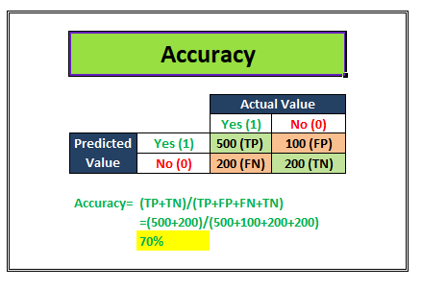
Model Performance Metrics
Accuracy
Accuracy is the proximity of measurement results to the true value. It tell us how accurate our classification model is able to predict the class labels given in the problem statement.
Accuracy= (TP+TN)/Total customers
Image Source: https://miro.medium.com/max/1400/1*tlrYPZgfX9cc1_RCPHPoJg.png
Notes:
Accuracy is a metric that is best used for a balanced dataset
Accuracy is the proximity of measurement results to the true value. It tell us how accurate our classification model is able to predict the class labels given in the problem statement.
For example: Let’s suppose that our classification model is trying to predict for customer attrition scenario. In the image above, Out of the total 700 actually attrited customers (TP+FN) , the model was correctly able to classify 500 attrited customers correctly (TP). Similarly, out of the total 300 retained customers (FP+TN), the model was correctly able to classify 200 retained customers correctly (TN).
Accuracy= (TP+TN)/Total customers
In the above scenario, we see that the accuracy of the model on the test dataset of 1000 customers is 70%.

Slide 13
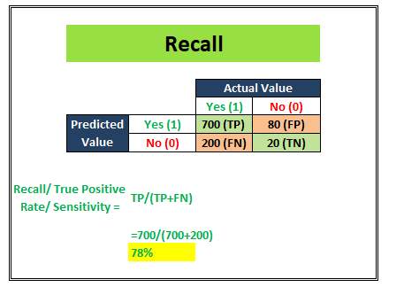
Model Performance Metrics
Recall
Recall/ Sensitivity/ TPR (True Positive Rate) attempts to answer the following question:
What proportion of actual positives was identified correctly?
Recall is generally used in use cases where the truth-detection is of utmost importance
Image Source: https://miro.medium.com/max/1400/1*tlrYPZgfX9cc1_RCPHPoJg.png
Notes:
Recall/ Sensitivity/ TPR (True Positive Rate) attempts to answer the following question:
What proportion of actual positives was identified correctly?
This metric gives us 78% as the Recall score in the above image. Recall is generally used in use cases where the truth-detection is of utmost importance. For example: The cancer prediction, the stock market classification, etc. over here the problem statement requires that the False negatives be minimized which implies Recall/Sensitivity be maximized.

Slide 14
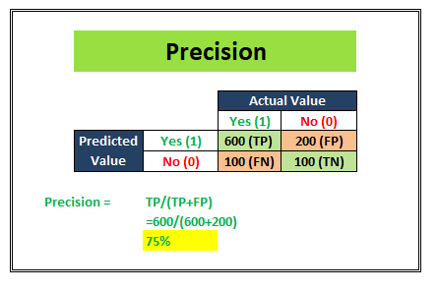
Model Performance Metrics
Precision
Precision attempts to answer the following question:
What proportion of positive identifications was actually correct?
Precision is generally used in cases where it’s of utmost importance not to have a high number of False positives
Image Source: https://miro.medium.com/max/1400/1*tlrYPZgfX9cc1_RCPHPoJg.png
Notes:
Precision attempts to answer the following question:
What proportion of positive identifications was actually correct?
The example shown in the above image shows us that the Precision score is 75%. Precision is generally used in cases where it’s of utmost importance not to have a high number of False positives. For example: In spam detection cases, as we discussed above, a false positive would be an observation that was not spam but was classified as Spam by our classification model. Too many of the false positives can defeat the purpose of a spam classifier model. Thus, Precision comes handy here to judge the model performance in this scenario.

Slide 15
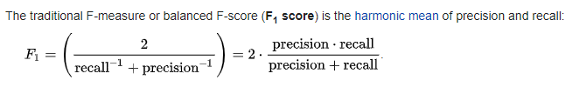
Model Performance Metrics
F1 score
F1 score (also F-score or F-measure) is a measure of a test’s accuracy. It considers both the precision p and the recall r of the test to compute the score
Image Source: https://miro.medium.com/max/1400/1*tlrYPZgfX9cc1_RCPHPoJg.png
Notes:
We understand that there are some problem statements where a higher Recall takes precedence over a higher Precision and vice-versa.
But there are some use-cases, where the distinction is not very clear and as developers, we want to give importance to both Recall and Precision. In this case, there is another metric- F1 Score that can be used. It is dependent on both Precision and Recall.
In a statistical analysis of binary classification, the F1 score (also F-score or F-measure) is a measure of a test’s accuracy. It considers both the precision p and the recall r of the test to compute the score

Slide 16

Python Library: Sci-Kit Learn
Sci-kit learn
Open-source ML library for Python. Built on NumPy, SciPy, and Matplotlib.
Scikit-learn is a library in Python that provides many unsupervised and supervised learning algorithms.
Image Source: scikit-learn: machine learning in Python — scikit-learn 1.0.2 documentation
Notes:
Open-source ML library for Python. Built on NumPy, SciPy, and Matplotlib.
Scikit-learn is a library in Python that provides many unsupervised and supervised learning algorithms. It’s built upon some of the technology you might already be familiar with, like NumPy, pandas, and Matplotlib!

Slide 17
Python Library: Sci-Kit Learn
Functionality of Sci-kit learn
Regression
Classification
Clustering
Model Selection
Pre-processing
Image Source: scikit-learn: machine learning in Python — scikit-learn 1.0.2 documentation
Notes:
The functionality that scikit-learn provides include:
Regression, including Linear and Logistic Regression
Classification, including K-Nearest Neighbors
Clustering, including K-Means and K-Means++
Model selection
Preprocessing, including Min-Max Normalization

Slide 18
Python Library: Sci-Kit Learn
Install Sci-kit learn
Using pip
pip install -U scikit-learn
Using conda
conda install scikit-learn
Image Source: scikit-learn: machine learning in Python — scikit-learn 1.0.2 documentation
Notes:
Installation
If you already installed NumPy and Scipy, following are the two easiest ways to install scikit-learn −
Using pip
Following command can be used to install scikit-learn via pip −
pip install -U scikit-learn
Using conda
Following command can be used to install scikit-learn via conda −
conda install scikit-learn
On the other hand, if NumPy and Scipy is not yet installed on your Python workstation then, you can install them by using either pip or conda.
Another option to use scikit-learn is to use Python distributions like Canopy and Anaconda because they both ship the latest version of scikit-learn.

Slide 19
Python Library: Sci-Kit Learn
Features Sci-kit learn
Supervised Learning algorithms
Unsupervised Learning algorithms
Clustering
Cross Validation
Feature extraction
Feature selection
Open Source
Image Source: scikit-learn: machine learning in Python — scikit-learn 1.0.2 documentation
Notes:
Features of scikit-learn
Rather than focusing on loading, manipulating and summarising data, Scikit-learn library is focused on modeling the data. Some of the most popular groups of models provided by Sklearn are as follows −
Supervised Learning algorithms − Almost all the popular supervised learning algorithms, like Linear Regression, Support Vector Machine (SVM), Decision Tree etc., are the part of scikit-learn.
Unsupervised Learning algorithms − On the other hand, it also has all the popular unsupervised learning algorithms from clustering, factor analysis, PCA (Principal Component Analysis) to unsupervised neural networks.
Clustering − This model is used for grouping unlabeled data.
Cross Validation − It is used to check the accuracy of supervised models on unseen data.
Dimensionality Reduction − It is used for reducing the number of attributes in data which can be further used for summarisation, visualisation and feature selection.
Ensemble methods − As name suggest, it is used for combining the predictions of multiple supervised models.
Feature extraction − It is used to extract the features from data to define the attributes in image and text data.
Feature selection − It is used to identify useful attributes to create supervised models.
Open Source − It is open source library and also commercially usable under BSD license.

Slide 20
Python Library: Sci-Kit Learn
Features
Feature matrix
Feature Names
Response
Response vector
Response Names
Sci-kit learn – Dataset Loading
Feature
Features Matrix
Features Names
Response
Response Vector
Response Names
Image Source: scikit-learn: machine learning in Python — scikit-learn 1.0.2 documentation
Notes:
Dataset Loading
A collection of data is called dataset. It is having the following two components −
Features − The variables of data are called its features. They are also known as predictors, inputs or attributes.
Feature matrix − It is the collection of features, in case there are more than one.
Feature Names − It is the list of all the names of the features.
Response − It is the output variable that basically depends upon the feature variables. They are also known as target, label or output.
Response Vector − It is used to represent response column. Generally, we have just one response column.
Target Names − It represent the possible values taken by a response vector.
Scikit-learn have few example datasets like iris and digits for classification and the Boston house prices for regression.

Slide 21
Python Library: Sci-Kit Learn
from sklearn.datasets import load_iris
iris = load_iris()
X = iris.data
y = iris.target
feature_names = iris.feature_names
target_names = iris.target_names
print("Feature names:", feature_names)
print("Target names:", target_names)
print("\nFirst 10 rows of X:\n", X[:10])
Sci-kit learn – Dataset Loading
Feature
Features Matrix
Features Names
Response
Response Vector
Response Names
Image Source: scikit-learn: machine learning in Python — scikit-learn 1.0.2 documentation
Notes:
Dataset Loading
A collection of data is called dataset. It is having the following two components −
Features − The variables of data are called its features. They are also known as predictors, inputs or attributes.
Feature matrix − It is the collection of features, in case there are more than one.
Feature Names − It is the list of all the names of the features.
Response − It is the output variable that basically depends upon the feature variables. They are also known as target, label or output.
Response Vector − It is used to represent response column. Generally, we have just one response column.
Target Names − It represent the possible values taken by a response vector.
Scikit-learn have few example datasets like iris and digits for classification and the Boston house prices for regression.

Slide 22
Python Library: Sci-Kit Learn
from sklearn.datasets import load_iris
iris = load_iris()
X = iris.data
y = iris.target
from sklearn.model_selection import train_test_split
X_train, X_test, y_train, y_test = train_test_split(
X, y, test_size = 0.3, random_state = 1
)
print(X_train.shape)
print(X_test.shape)
print(y_train.shape)
print(y_test.shape)
Sci-kit learn – Splitting dataset
from sklearn.model_selection import train_test_split
Image Source: scikit-learn: machine learning in Python — scikit-learn 1.0.2 documentation
Notes:
Splitting the dataset
To check the accuracy of our model, we can split the dataset into two pieces-a training set and a testing set. Use the training set to train the model and testing set to test the model. After that, we can evaluate how well our model did.
Example
The following example will split the data into 70:30 ratio, i.e. 70% data will be used as training data and 30% will be used as testing data. The dataset is iris dataset as in above example
As seen in the example above, it uses train_test_split() function of scikit-learn to split the dataset. This function has the following arguments −
X, y − Here, X is the feature matrix and y is the response vector, which need to be split.
test_size − This represents the ratio of test data to the total given data. As in the above example, we are setting test_data = 0.3 for 150 rows of X. It will produce test data of 150*0.3 = 45 rows.
random_size − It is used to guarantee that the split will always be the same. This is useful in the situations where you want reproducible results.

Slide 23
Python Library: Sci-Kit Learn
from sklearn.linear_model import LinearRegression
from sklearn.metrics import mean_squared_error, r2_score
regression_model = LinearRegression()
regression_model.fit(x_train, y_train)
y_predicted = regression_model.predict(x_test)
rmse = mean_squared_error(y_test, y_predicted)
Sci-kit learn – Linear Regression
This supervised ML model is used when the output variable is continuous and it follows linear relation with dependent variables. It can be used to forecast sales in the coming months by analyzing the sales data for previous months.
Image Source: scikit-learn: machine learning in Python — scikit-learn 1.0.2 documentation
Notes:
Linear Regression
This supervised ML model is used when the output variable is continuous and it follows linear relation with dependent variables. It can be used to forecast sales in the coming months by analyzing the sales data for previous months.
With the help of sklearn, we can easily implement the Linear Regression model as follows
r2 = r2_score(y_test, y_predicted)
LinerRegression() creates an object of linear regression. Then we fit the model on the training set. Finally, we predicted the model on the test dataset. “rmse” and “r_score” can be used to check the accuracy of the model.

